Slide 2
Power transport and management in beamlines
Philipp Brumund and Manuel Sanchez del Rio
brumund@esrf.fr srio@esrf.fr
Advanced Analysis & Precision Unit, MEG/ISDD, ESRF
March 21st 2025

Slide 3
Outline
1.
Introduction
2.
Source emission
3.
Materials & Physics
4.
Heat Load Components

Slide 4
Introduction (1) – Power transport and management
Beamline component
Part 1: Source - Manuel
Materials + Physical phenomena
Temperature increases
Mechanical stress/strain increase
$$T,σ,ε↑$$
Cooling
Power
X-rays (light)
Design Goals
No damage
Slits
Filters
(X-ray optics)
Optical performance (“shape/flatness”)
Mirrors
Multilayers
Monochromators
Part 2: Materials, physics (Manuel/Philipp)
Part 3: Components (Philipp)

Slide 5
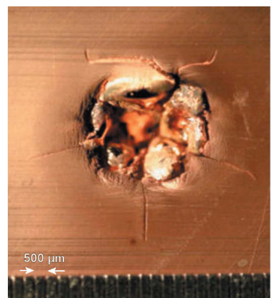
Introduction (2) - Goals
power
Scientists don’t want this…
No damage
No melting (temperature)
Acceptable stresses
“reflected”
(distorted)
Incoming x-rays
Thermal deformations
Optical performance (“shape/flatness”)
Deformation of optics should not distort wavefront
X-ray optics
With initial surface shape

Slide 6
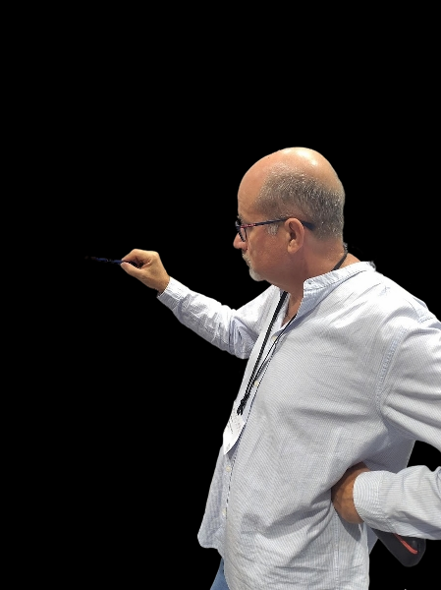

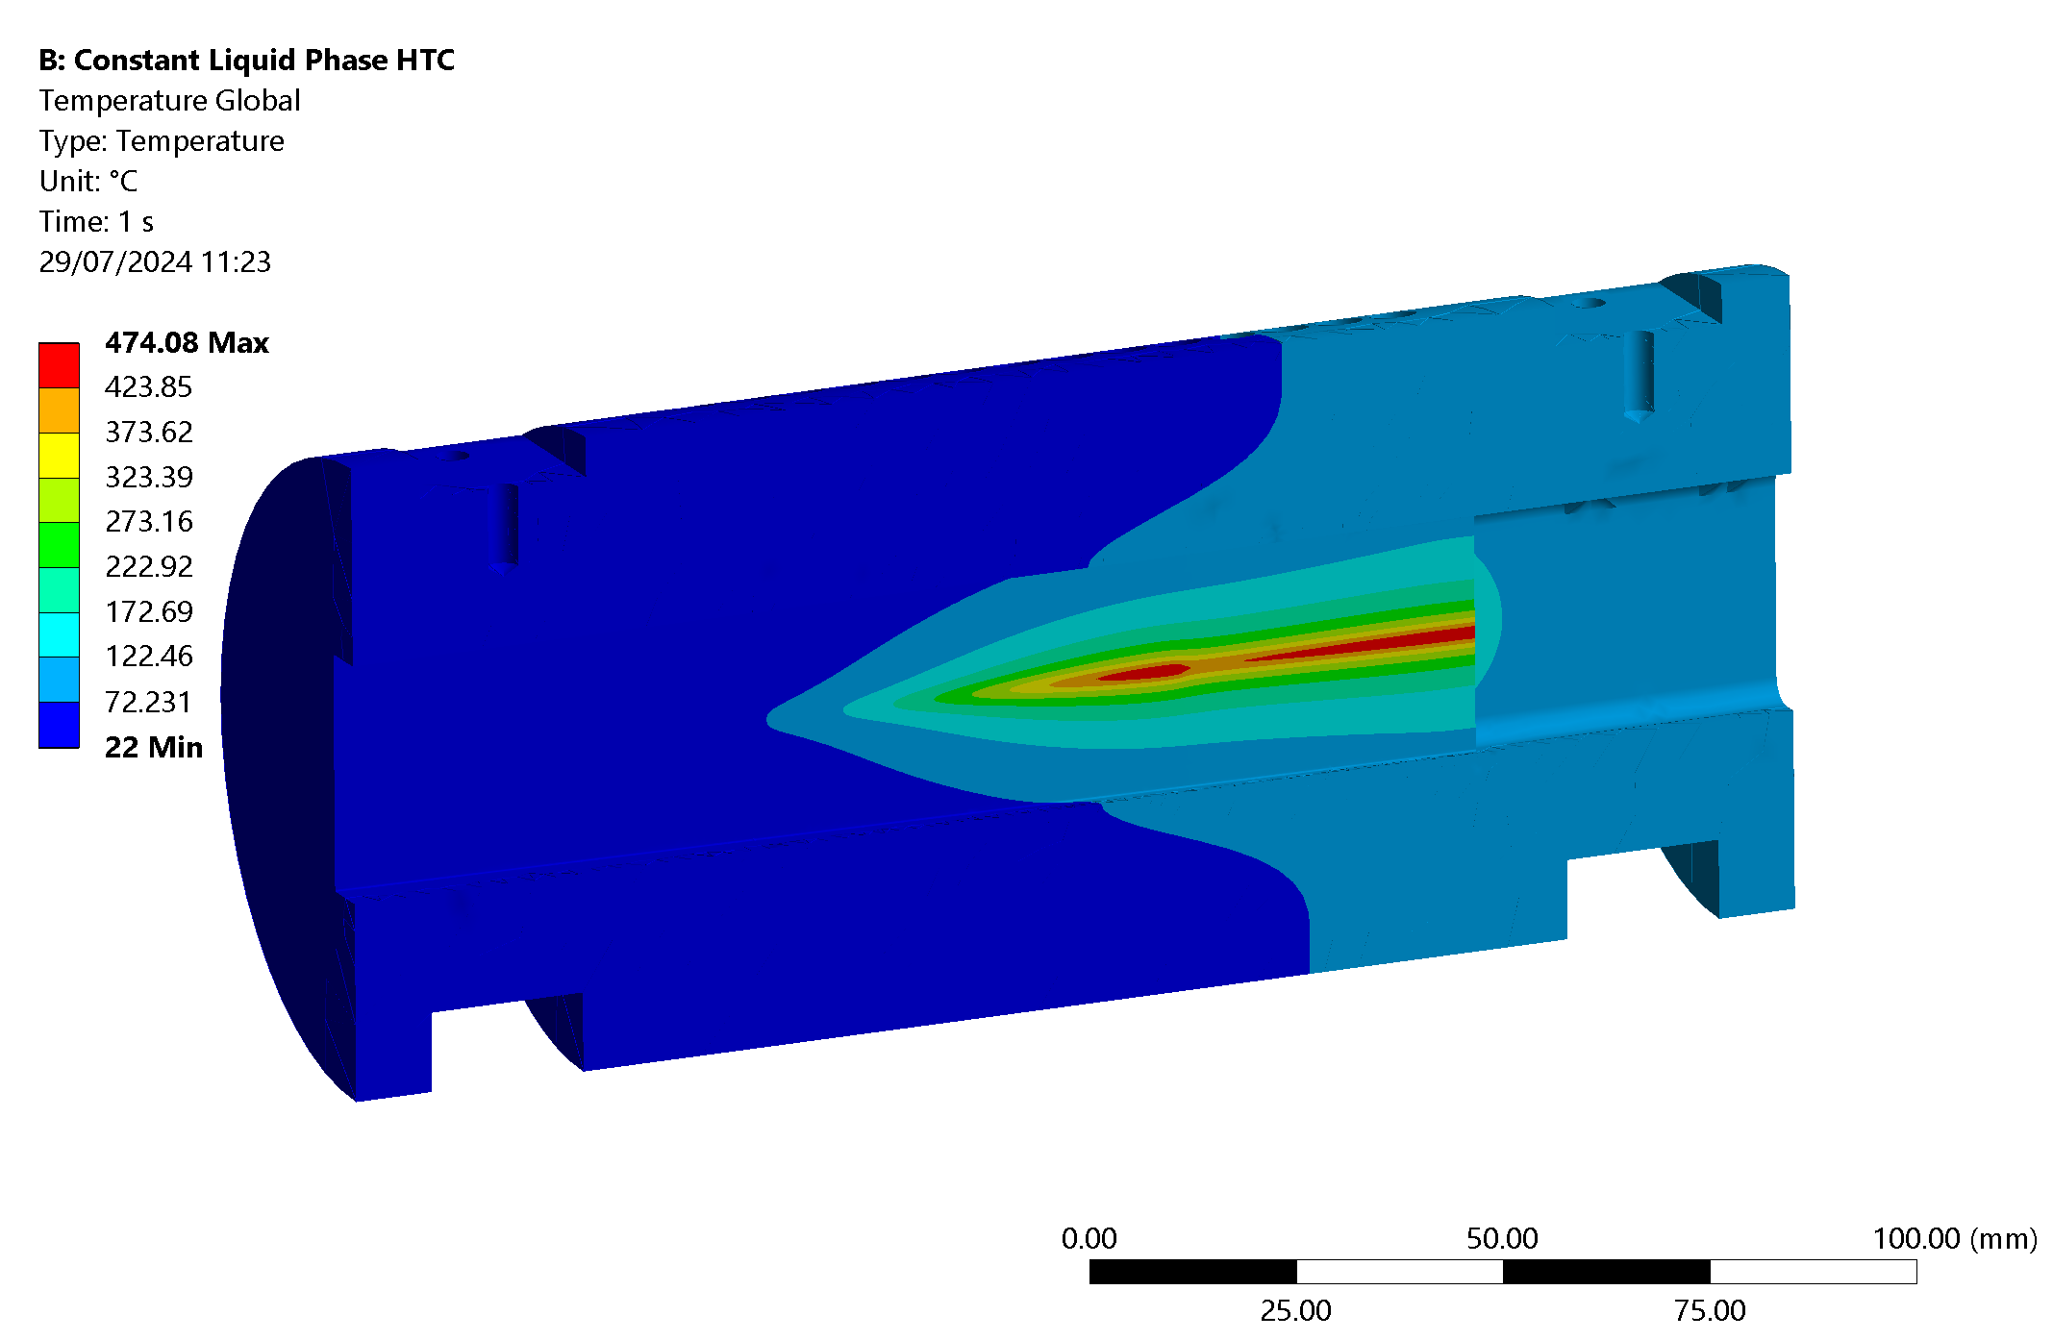
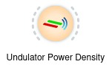
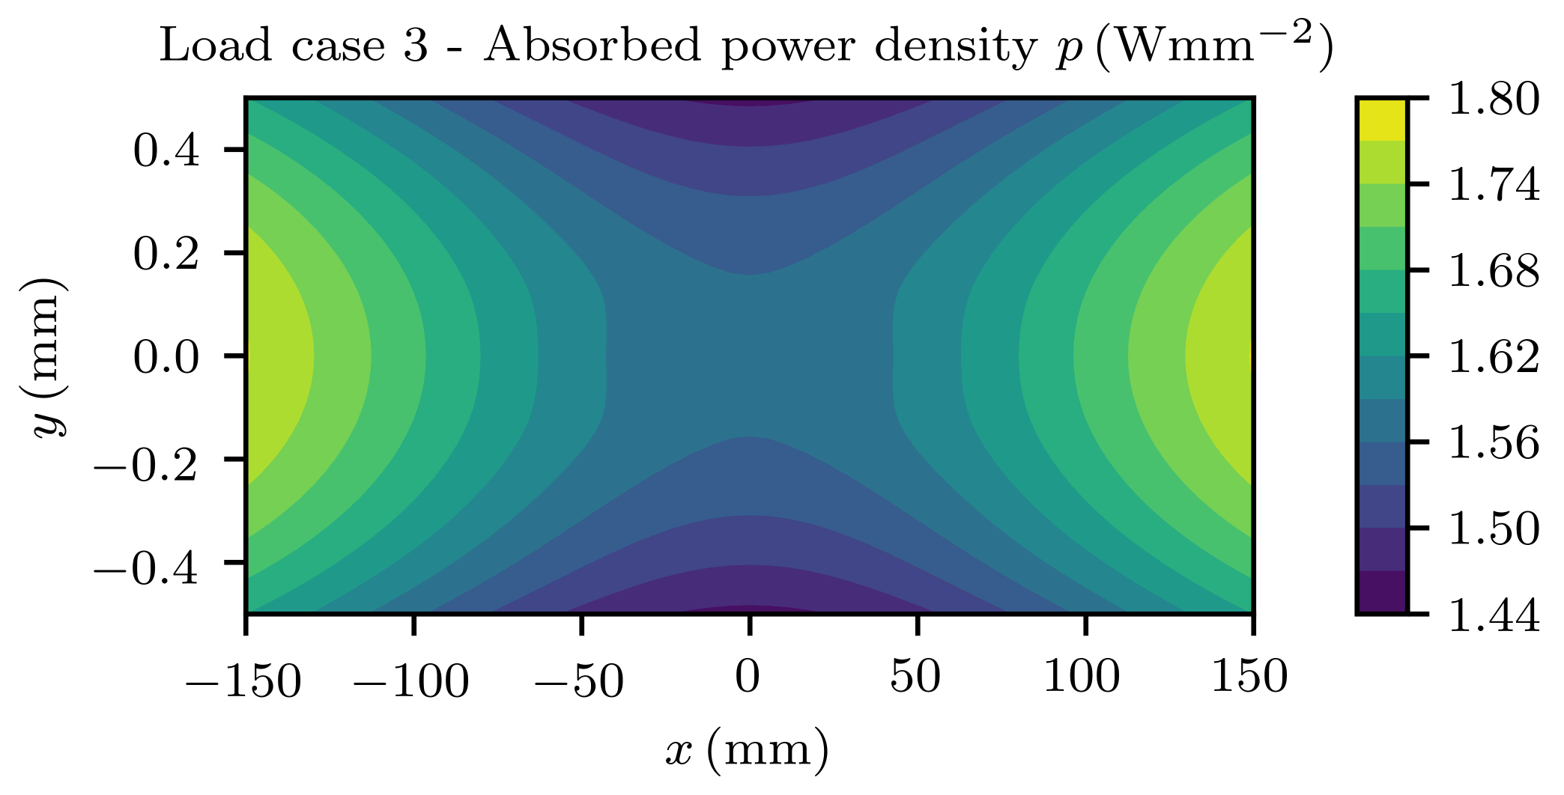
Introduction (3) – Typical Power Design process
Achtung !
Manolo
Philipp
OASYS/
Xoppy
Heat Load
ANSYS (FEA)
Postprocessing
(specific code or OASYS)

Slide 7
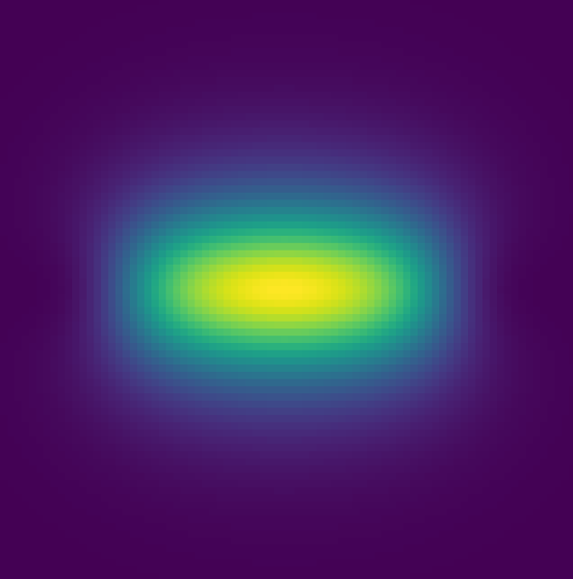
2 Source emission
2 Source emission

Slide 8
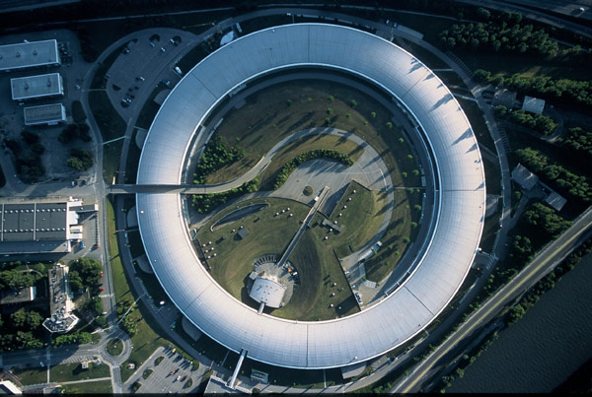
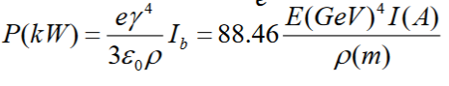
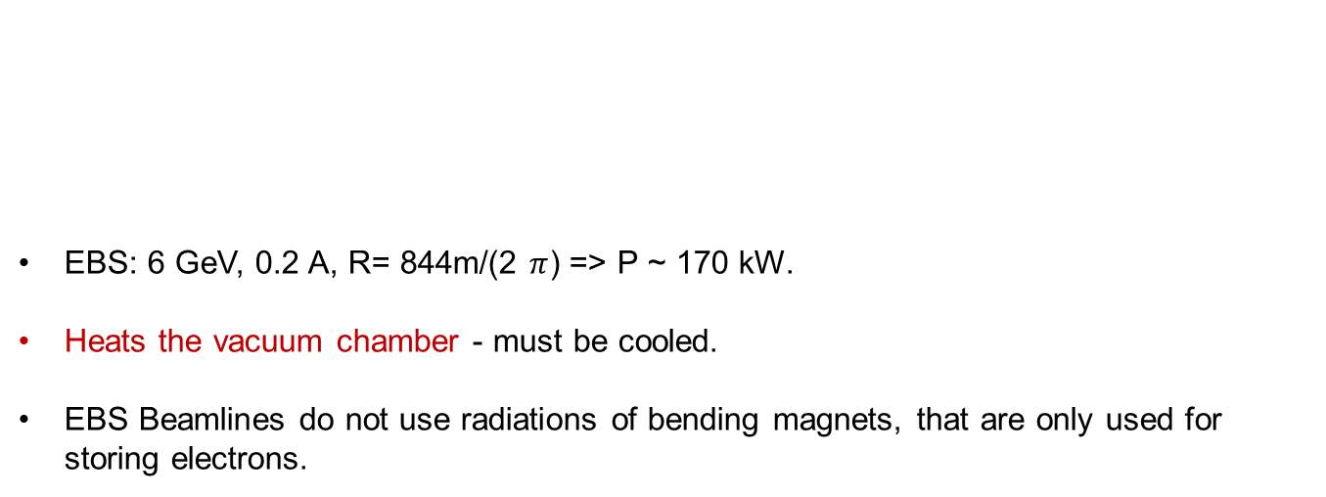
Power emitted as synchrotron radiation in a storage ring
EBS: 6 GeV, 0.2 A, R= 844m/(2 $π$) => P ~ 170 kW.
Heats the vacuum chamber - must be cooled.
EBS Beamlines do not use radiations of bending magnets, that are only used for storing electrons.

Slide 9
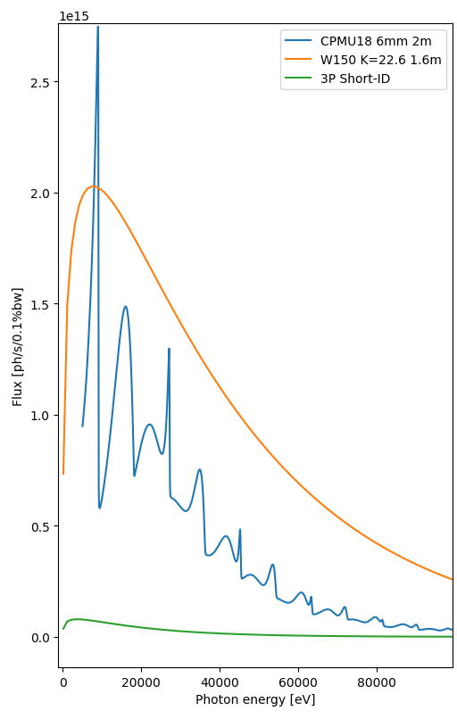
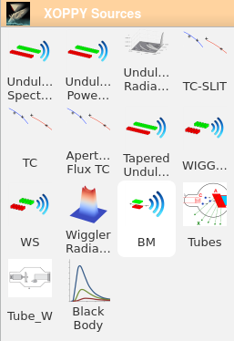
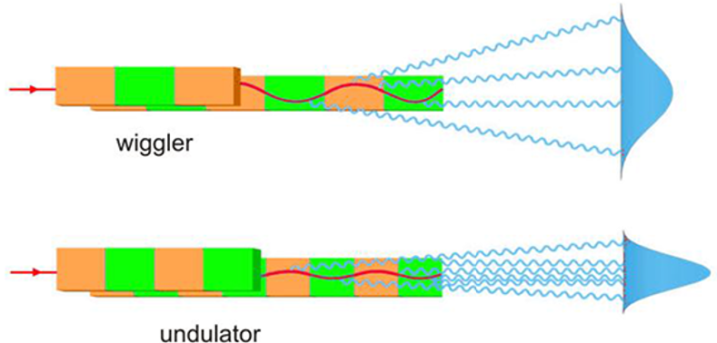
Beamline sources: insertion devices
Source spectrum (Photon “flux” or “spectral power” vs Energy)
XOPPY
top view

Slide 10
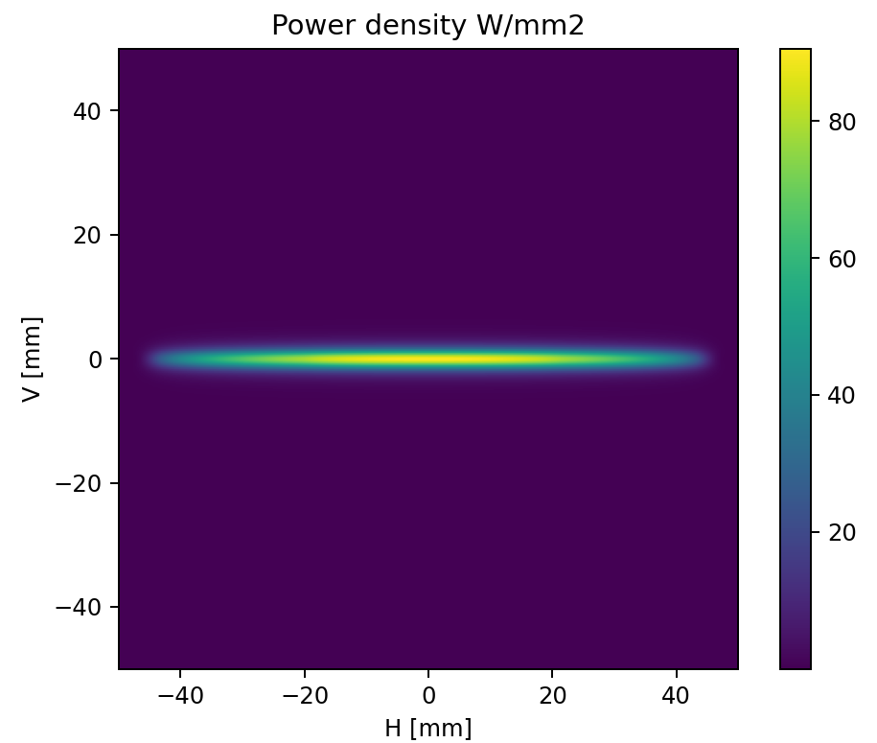
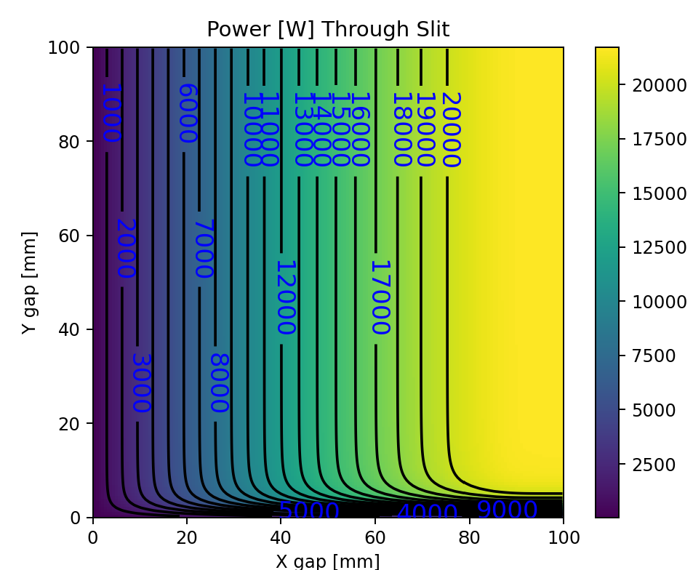
Wiggler (W150 ID17) @ 23.7m
$P\left(kW\right)=0.633 E^{2} B^{2}L I$= 0.633 * 6**2 * 1.61**2 * 1.6 * 0.2 = 18.96 kW

Slide 11
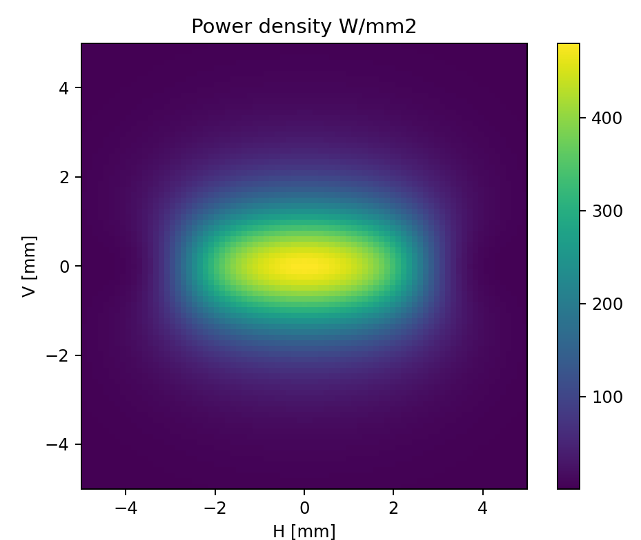
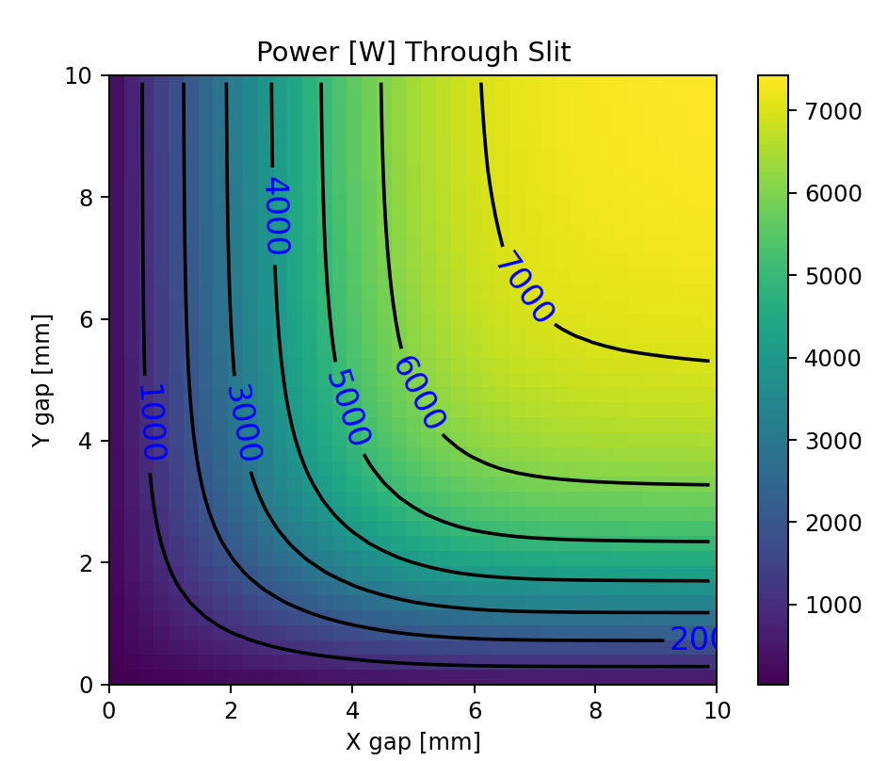
Undulator (CPMU18 2m 6mm gap) @ 23.7m
$P\left(kW\right)=0.633 E^{2} B^{2}L I$= 0.633 * 6**2 * 0.88**2 * 2.0 * 0.2 = 7.05 kW

Slide 12
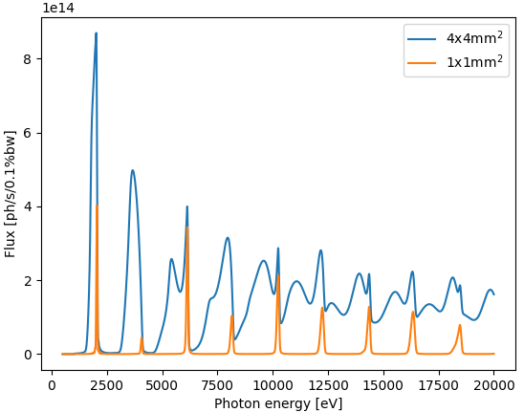
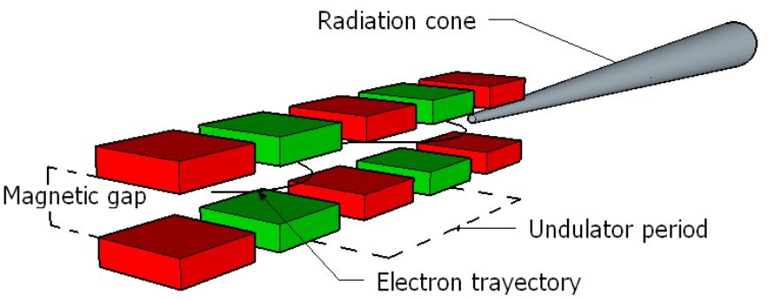
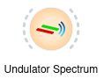
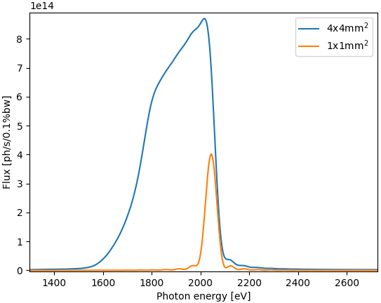

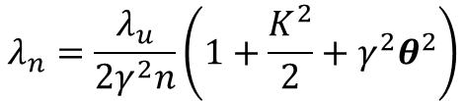
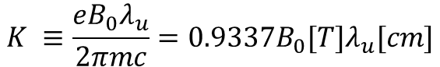
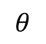
Undulator emission
XOPPY
$$K ≡\frac{eB_{0}λ_{u}}{2πmc}=0.9337B_{0}[T]λ_{u}[cm]$$
$$λ_{n}=\frac{λ_{u}}{2γ^{2}n}\left(1+\frac{K^{2}}{2}+γ^{2}θ^{2}\right)$$
Slit
U42
$$θ$$
30 m

Slide 13

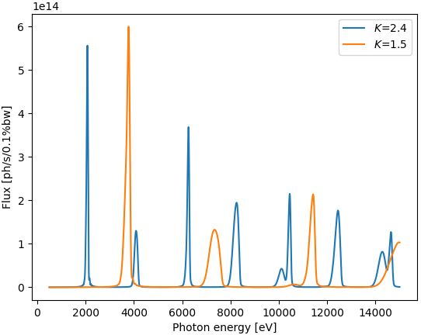
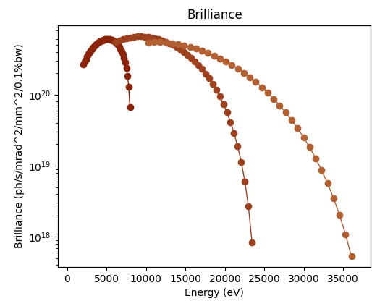
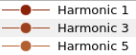
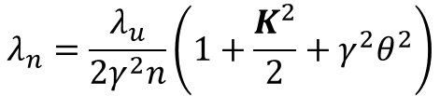
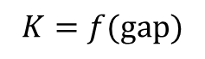
Undulator emission
XOPPY
$$λ_{n}=\frac{λ_{u}}{2γ^{2}n}\left(1+\frac{K^{2}}{2}+γ^{2}θ^{2}\right)$$
U42
$$K=f(gap)$$
Undulator is tunable

Slide 14

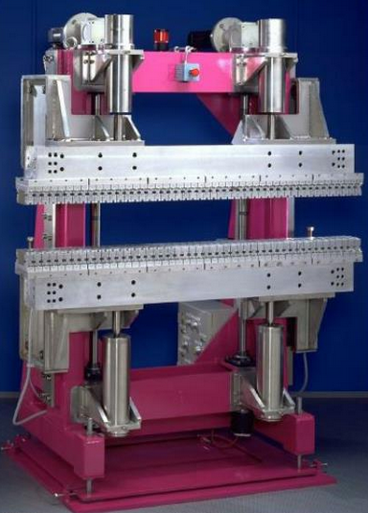

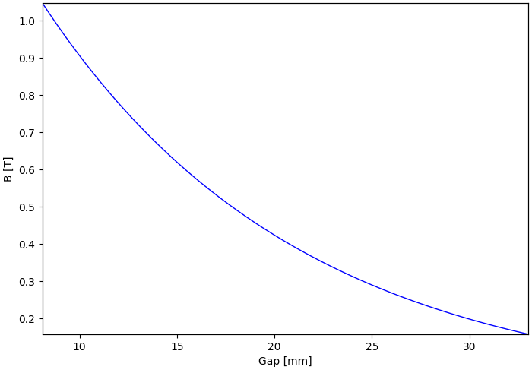
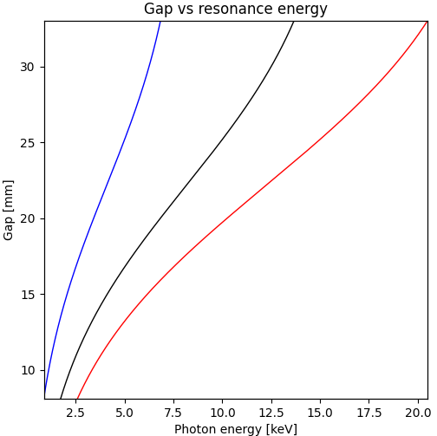

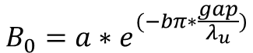
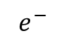
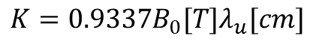
Undulator emission EBS catalog
$$e^{−}$$
Gap
$$B_{0}=a∗e^{(−bπ∗\frac{gap}{λ_{u}})}$$
$$K=0.9337B_{0}[T]λ_{u}[cm]$$
For ID21 U42b:
a=1.9395
b=1.0164

Slide 15
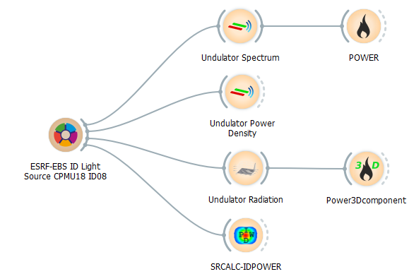
OASYS: Simulation of source emission
1D: Undulator Flux and Spectral Power (flux/power vs E)
2D: Undulator power density (power vs x, y)
3D: Undulator spectral flux density (flux/power vs x, y, E)
SRCALC Undulator spectral flux density (power vs x, y, E_{i})

Slide 16
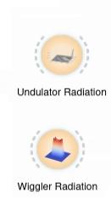
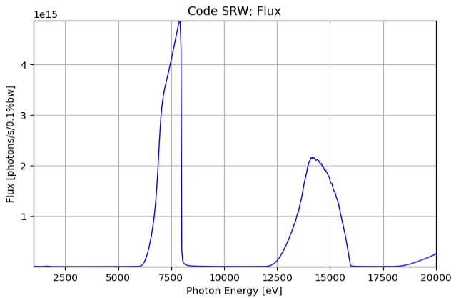
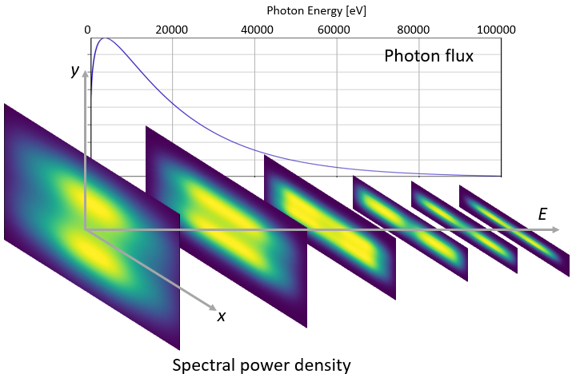
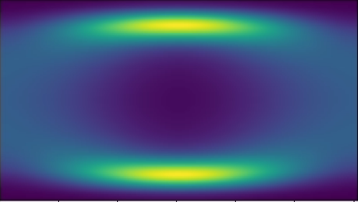
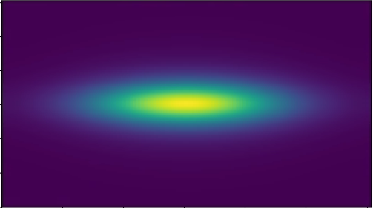
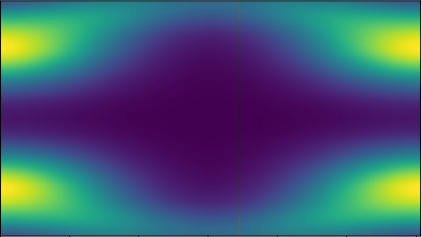
Simulation of source emission
Undulator spectral flux density
(flux/power vs x, y, E)
Wiggler spectral flux density
(flux/power vs x, y, E)
Photon Energy [eV]
1000 5000 10000 15000 20000
y
Photon flux
E
x

Slide 17
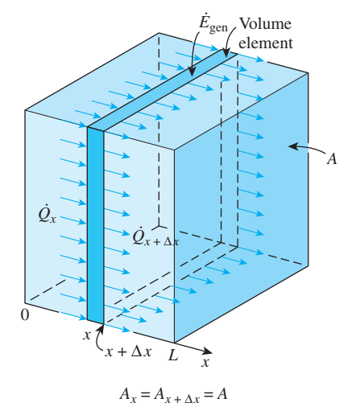
3 Material characteristics
3 Material characteristics

Slide 18
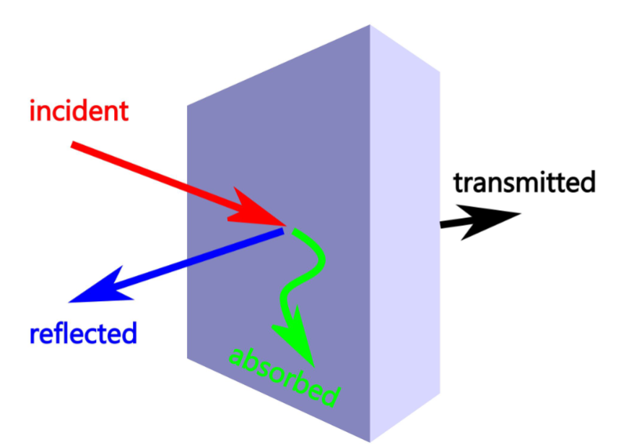
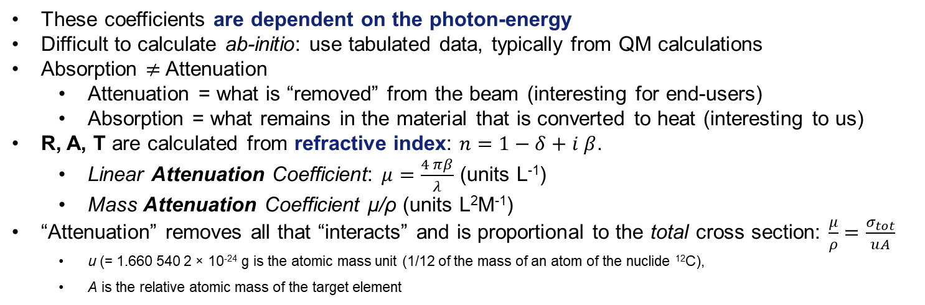
The Photon-Material interactions: what is “absorbed”?
I = R + A + T = 1
“Reflectors” (T=0)
1 = R + A
“Transmitters” (R=0)
1 = A + T
These coefficients are dependent on the photon-energy
Difficult to calculate ab-initio: use tabulated data, typically from QM calculations
Absorption $≠$Attenuation
Attenuation = what is “removed” from the beam (interesting for end-users)
Absorption = what remains in the material that is converted to heat (interesting to us)
R, A, T are calculated from refractive index: $n=1−δ+i β$.
Linear Attenuation Coefficient: $μ=\frac{4 πβ}{λ}$ (units L⁻¹)
Mass Attenuation Coefficient μ/ρ (units L²M⁻¹)
“Attenuation” removes all that “interacts” and is proportional to the total cross section: $\frac{μ}{ρ}=\frac{σ_{tot}}{uA}$
u (= 1.660 540 2 × 10⁻²⁴ g is the atomic mass unit (1/12 of the mass of an atom of the nuclide ¹²C),
A is the relative atomic mass of the target element

Slide 19
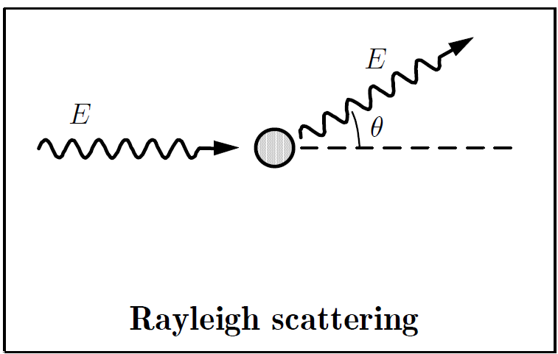
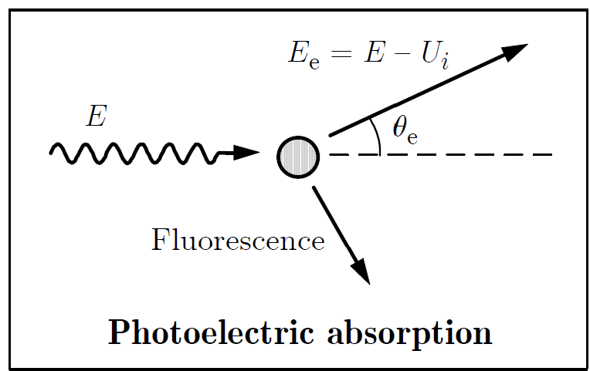
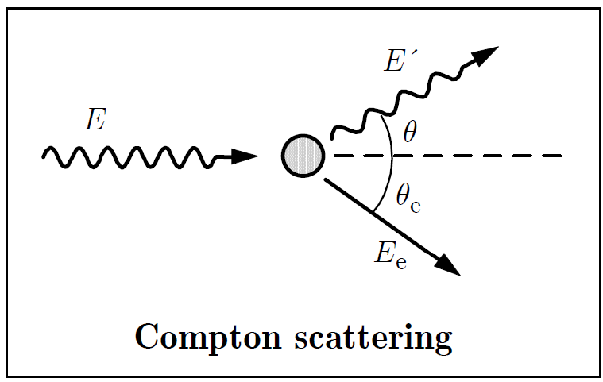
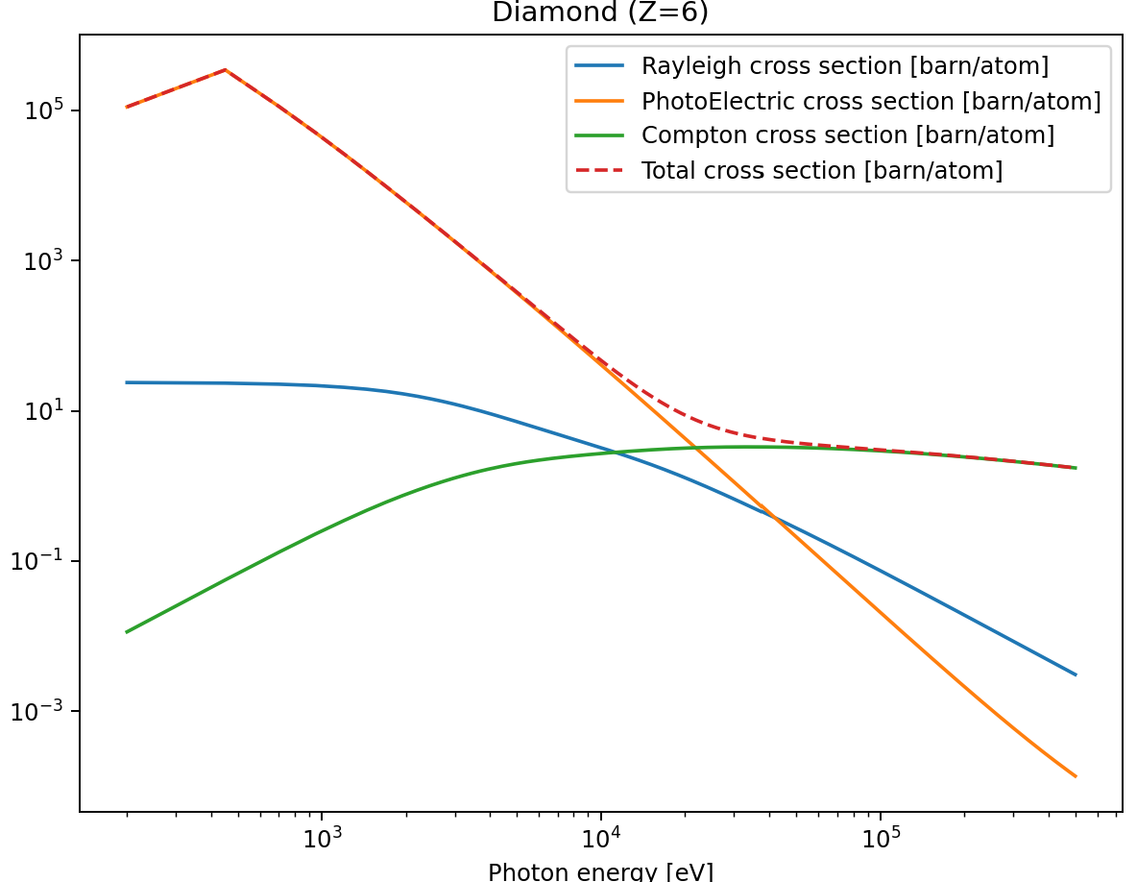
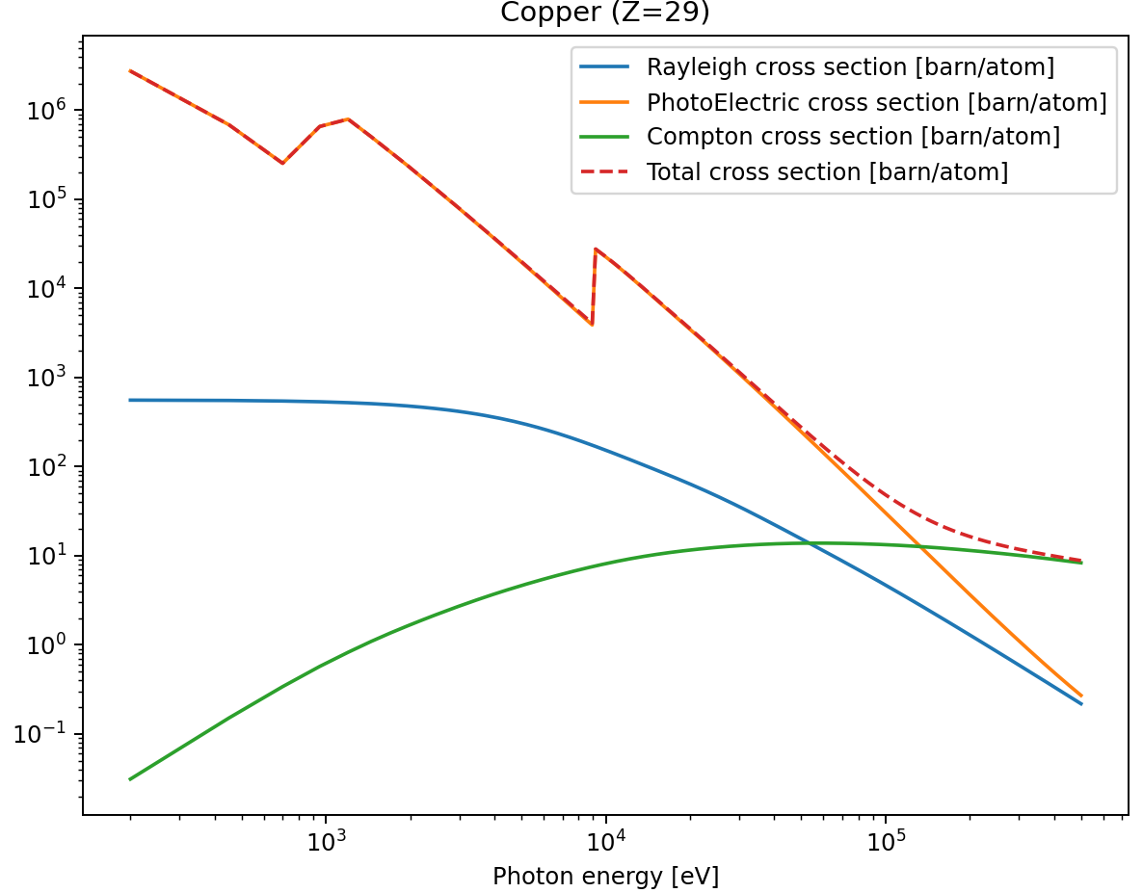

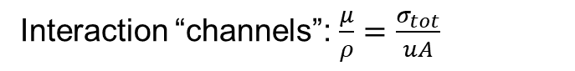
The interaction channels
Interaction “channels”: $\frac{μ}{ρ}=\frac{σ_{tot}}{uA}$

Slide 20



Particle absorption dose
For very accurate calculations use Monte Carlo Particle Tracking codes
For approximated calculations use the Energy-absorption Mass Coefficient: μ_{en}/ρ: μ_{en} = μ (1-g) https://www.nist.gov/pml/x-ray-mass-attenuation-coefficients
A pessimistic approach (that we use) is to suppose μ_{en}=μ thus overestimating a bit the absorption (stay safe!)
Thermalization: locally deposited energy is transformed in thermal energy
These processes involve a particle “shower”
Electrons are mostly thermalized (absorbed locally in form of heat)
Photons are more mobile, and tend to re-scatter or escape from the material
The energy (dose) deposited (absorbed) in the material depends on the particular geometry.

Slide 21



Practical e.g.: power to be removed - CMPU18 at 6mm gap
The Front End crops a 7kW beam (at minimum gap)
Compute Flux at 2x1 mm@23m
The integral gives
total power ~1kW
x 1000 x e (1.6e-19)
absorb low-energies: attenuators (High-pass filters)
absorb high-energies: mirrors (Low-pass filters)

Slide 22




Power absorbed by an attenuator
thickness
X-ray beam
Absorption
material & density
Heat load on filters on flux 2 mm x 1 mm @ 23 m:
Material | Thickness [μm] | Absorbed Power [W]
Be | 300 | 19
Diamond | 300 | 40
U42-EBS

Slide 23






Power Absorbed by Mirror
1st Harmonic
Same material, different angles Same angle, different coatings
Absorbed power 113 W
Reflectivity
Reflectivity
Example of reflection, primarily mirrors @ 30 m
1st Harmonic
3rd Harmonic
3rd Harmonic
Absorbed power 52 W

Slide 24





Attenuator and Mirror absorption
Heat load on attenuators @ 23 m with a projection of 2 mm x 1 mm:
Be (300 μm)
Diamond (300 μm)
Heat load on mirrors @ 30 m: Si (7 mrad) Diamond (100 μm) + Rh (3 mrad

Slide 25


Thermal Conductivity
Previous slides: calculation of heat load
Now: physics to deal with them – (mainly) thermal conductivity
One-dimensional heat equation [1]
$$k\frac{∂^{2}T}{∂x^{2}}=ρc_{p}\frac{∂T}{∂t}$$
(neglecting thermal source terms ${\dot{e}}_{gen}$)
Steady-state ($\frac{∂T}{∂t}=0$) and constant boundary rate of thermal energy ${\dot{Q}}_{x}$ $[W=J/s]$ and wall size $A$
$${\dot{Q}}_{x}=−kA\frac{dT}{dx}$$
(Fourier’s law of heat conduction)
Thermal gradients inversely proportional to conductivity (for 1-D planar)
$$\boxed{\frac{dT}{dx}∝\frac{1}{k}}$$
$k$ : thermal conductivity
$c_{p}$: specific heat
$ρ:$ density
[1] A. J. Ghajar and D. Yunus A. Cengel, Heat and Mass Transfer: Fundamentals and Applications. McGraw-Hill Education, 2014.

Slide 26









Typical Conductivities
Thermal gradients inversely proportional to conductivity (for 1-D planar):
$$\boxed{\frac{dT}{dx}∝\frac{1}{k}}$$
Thermal conductivity $k$ critical to reduce thermal gradients
Low thermal expansion $α$ and high mechanical resistance $σ_{y}$ critical for thermal stresses
$$k/α$$
Diamond
Silicon
($T:$LN2)
Coppers
(high $σ_{y}$)
Quite bad absorbers…
Stainless steel
$$σ_{y}$$

Slide 27


Other Modes of Heat Transfer
Convection
Forced convection: internal Water/LN2 cooling with “tubing”
Cooling linked to convection coefficient from empirical equations (${\dot{Q}}_{c}$wanted high)
$$h=f\left(\dot{m},c_{p}\right)≠f(T)$$
$${\dot{Q}}_{c}=\left(T_{S}−T_{∞}\right)hA_{S}$$
Radiation
Not discussed here
At high temperature differences

Slide 28



Why Finite Element Analysis (FEA)?
Simple geometries: analytical solutions exist
Continuous solution
Solved: analytical differential equation
$$k\frac{∂^{2}T}{∂x^{2}}=ρc_{p}\frac{∂T}{∂t}$$
Complex geometries: FEA mesh captures nearly any desired shape
Discrete solution
FEA easily permits to use non-linear properties
Conductivities (thermal)
Stress-strain relationships (mechanical)
Today: fast to solve & looks better ☺
Solved: discrete system
$$\left[K\right]\left[T\right]=\left[q\right]$$

Slide 29


4 Beamline power components
4 Beamline power components
Focusing system
Front end
Primary slits
Monochromator
Source
Sample
Primary mirrors
KB mirrors
Water-cooled
slits
Lenses
Windows

Slide 30



Example in numbers: Power Transport on ID03
Undulator: CPMU16.4 (2m, gap 4mm)
Total power 20kW
Science needs power!
Comparison: French person 2223 kWh/year (4days CPMU)
And: Thierry Brochard cycling ~50W (rounded) $⇒$ 1xCPMU = 400 Thierrys
Sample: $≪1W$

Slide 31


Higher expected future heat-loads
Juan Reyes approved!
Increased use of cryogenic permanent magnet undulators (CPMUs)
Code: OASYS
Insertion device
Gap
Total Power
Power Density (in
Comment
(length)
(mm)
(kW)
16.1m)
(W/mm2)
CPMU16.4 (2m)
4.0 mm
20.1
1947
ID03
-
4mm (“mini
-
beta”)
CPMU20.5 (4m)
5.5 mm
29.6
2716
Plan for double CPMU – ID20
Recent front end review
See confluence: https://confluence.esrf.fr/x/e-VwBg

Slide 32




Slits: Front end
Typical optical components that can be present in a beamline:
Absorbed powers
18 kW
4 kW
150 W
Focusing system
Front end
Primary slits
Monochromator
Source
Sample
Primary mirrors
KB mirrors
Water-cooled
slits
Windows
0.5 kW
2 kW
Source
Vertical plane
Horizontal Slit
Glidcop Al-15
$$d=16.1m$$
Design goal:
No damage
Jeff Wade

Slide 33



Used: Undulator power density (Power vs x, y)
This OASYS/Xoppy tool is very useful to get the heat load on a slit
Water cooled beamline slit
undulator

Slide 34



FEA Simulations (e.g. slits): One-way coupled thermo-mechanical FEA
Thermal model
Cooling coefficient from Dittus-Boelter correlation
Heat loads projected on surface elements
FEA Software ANSYS

Slide 35


FEA Simulations Slits: Typical Results
Temperature field
Min. principal strains (compression)
Total mechanical strain = elastic + plastic
Usually plastic strains occurring!
1st Hor. Slit
Glidcop Al-15
Heat load: CPMU20.5 (4m) at 5.5mm gap

Slide 36

Front End – Horizontal Slit (redesign)
Video of new future design in high-resistance copper CuCr1Zr
Water inlet on one side
Cross section:
5 channels per side
Slit cutting to 2mm horizontal
Channels in series
Crossing to other side through hole
Slope optimized for heat load profile
Design conform to specs

Slide 37






Windows
Absorbed powers
18 kW
4 kW
Focusing system
Front end
Primary slits
150 W
Monochromator
Source
Sample
Primary mirrors
KB mirrors
Water-cooled
slits
Windows
2 kW
0.5 kW
Diamond window
$$Ø6mm$$
Diamond conductivity $k(T)$
temperature dependence important
beam
$$130mm$$

Slide 38




Power transport on a beamline
18 kW
Absorbed powers
4 kW
150 W
Focusing system
Front end
Primary slits
Monochromator
Source
Sample
Primary mirrors
KB mirrors
Water-cooled
slits
Windows
2 kW
0.5 kW
Similar to Front end Slits
But: adjustable
X-ray beam
Filippo Cianciosi

Slide 39


Multilayer: ID03
18 kW
4 kW
150 W
Focusing system
Absorbed powers
Front end
Primary slits
Monochromator
Source
Sample
Primary mirrors /
multilayer
KB mirrors
Water-cooled
slits
Windows
2 kW
0.5 kW
Absorption by filters
Absorbed power by multilayer
Slit 1
Work with C. Detlefs
Design goals:
No damage +
optical performance
Design: Carole Clavel, D. Baboulin

Slide 40


Multilayer: Absorbed power
Wide energy bandwidth
Complex absorption profile on substrate
Power density profile on surface of x-ray optic
Imported to FEA model

Slide 41




Multilayer: Thermal deformations
Mirror cross-section can influence deformations
Split in 2 deformation components
Bending (curvature) with radius (here 73km) can be partially corrected downstream
With adaptive focusing optics (lenses in case of ID03)
Residual deformations not
Results for one geometrical parameter set
“Optimization” of geometry considering all working energies and parameter sets [1]
[1] P. Brumund, C. Detlefs et al., “Thermal optimization of a high-heat-load double-multilayer monochromator,” J Synchrotron Rad, vol. 28, no. 5, pp. 1423–1436, Sep. 2021, doi: 10.1107/S160057752100758X.

Slide 42
Monochromator
18 kW
4 kW
150 W
Absorbed powers
Focusing system
Front end
Primary slits
Monochromator
Source
Sample
Primary mirrors
KB mirrors
Water-cooled
slits
Windows
2 kW
0.5 kW
Absorbed power by monochromator:
All remaining power
Absorption by filters
Slit 1
Source
Design goals:
No damage +
optical performance

Slide 43






Power: Primary mirror / Multilayer VS. Monochromators
Both: high power optics
Important difference: projected power densities on optics surface
$$p=p_{⊥}\sin{(Θ)}$$
$p_{⊥}=const.$ (ID emission)
Silicon monochromators:
Crystal diffraction with lattice $d$ spacing
Bragg-angle $Θ_{B}$, depending on energy $E$ and wavelength $λ$, from Bragg-law
$$λ=\frac{hc}{E}=2d\sin{(Θ_{B})}$$
High projected power densities
Liquid-nitrogen (LN2) cooling necessary
x-rays
$$Θ_{B}>Θ_{1}$$
$$0^{∘}<Θ_{B}<{90}^{∘}$$
Mirrors/multilayers:
Reflection/layer diffraction
Small glancing angles $Θ_{1}$
Low projected power densities:
Water cooling sufficient
And: can not be “overfilled”
Very intense hotspot
x-rays
$$Θ_{1}<1^{∘}$$

Slide 44



Monochromator - Temperature
Mostly made of silicon
non-linearity of silicon thermal conductivity becomes clear
$$T_{max}$$

Slide 45


Monochromator - Deformations
Surface deformations for increasing absorbed powers
Silicon at liquid nitrogen temperatures
$$T≈77K$$
First concave then convex (with increasing power) – typical silicon cryogenic behaviour [1,2]
Due to first negative thermal expansion at cryogenic temperatures ($T≈80K$)
[1] L. Zhang et al., “Thermal deformation of cryogenically cooled silicon crystals under intense X-ray beams: measurement and finite-element predictions of the surface shape,” Journal of Synchrotron Radiation, vol. 20, no. 4, pp. 567–580, Jul. 2013, doi: 10.1107/S0909049513009436.
[2] P. Brumund, J. Reyes-Herrera, C. Detlefs, C. Morawe, M. Sanchez del Rio, and A. I. Chumakov, “Design simulations of a horizontally deflecting high-heat-load monochromator,” J Synchrotron Rad, vol. 28, no. 1, Jan. 2021, doi: 10.1107/S1600577520014009.

Slide 46


Lenses - ID03
Typical optical components that can be present in a beamline:
Focusing system
Front end
Primary slits
Monochromator
Source
Sample
Primary mirrors
KB mirrors
Water-cooled
slits
Lenses
Windows
Pinhole
Ø0.8mm
Al-Lens
CPMU16 (Kmax=2.08)
Front End
Diamond Window
$$t=0.4mm$$
DMM
Filters to pink beam
Generally stack of compound refractive lenses
“Transfocator”

Slide 47




Lenses - Absorption
Absorbed power in Aluminum lens calculated
Lens geometry
$R=0.2mm$, upstream pinhole Ø0.8mm
Decision for diamond lenses (aluminium above melting temperature)
Absorption in aluminum lens
Applied to FEA model

Slide 48
5 Summary
Beamline power simulations usually done in conjunction of
OASYS heat-load calculations
FEA thermo-mechanical simulations

